Slide 1
Exit Insight of Why People left
Human Resources Department

Slide 2



Goals of this discussion
Overview
Details
Solution
To share the overview about the turnover situation of the company
How people are doing in your department and by age and tenure
What to do next to improve and fix the problem

Slide 3
Table of Contents
1
5
Overview
Group overview and quarterly summary
Into the myth of salary
Leavers’ salaries breakdown by pay group
2
6
How long employees stay
Leavers breakdown by tenure, department
and age
Feedback
Exit Feedback, Interview Catch-up and eNPS result
3
7
Genders
Leavers breakdown by genders
Conclusion and Solution
Overall result and Next Steps
4
New Joiners
How are new joiners doing at the moment?

Slide 4
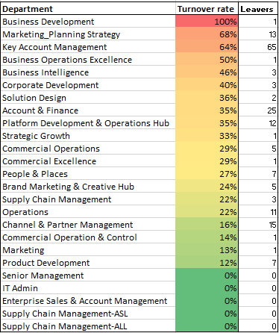
Overview of Turnover Situation (YTD)
Group Wide Turnover : 32%
Key Takeaway:
Group wide turnover rate is 32%
The highest turnover rate are from MPS, KAM and Business Operations Excellence
YTD Headcount : 596
YTD Exit : 182
Note:
Business Development only have one employee since the beginning of this year

Slide 5
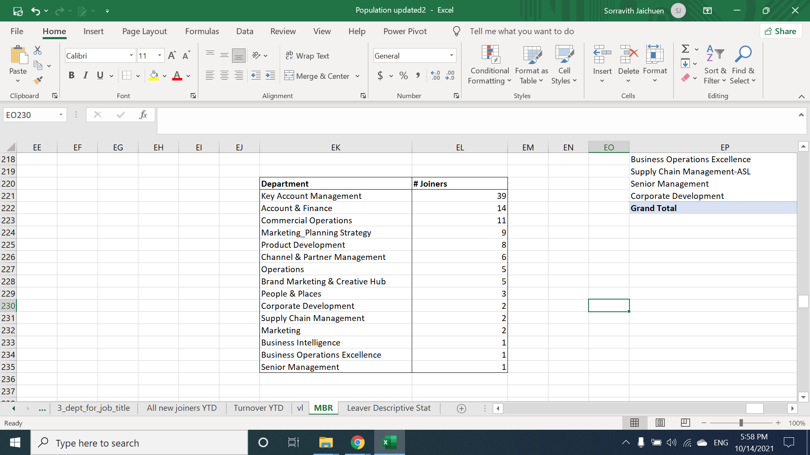
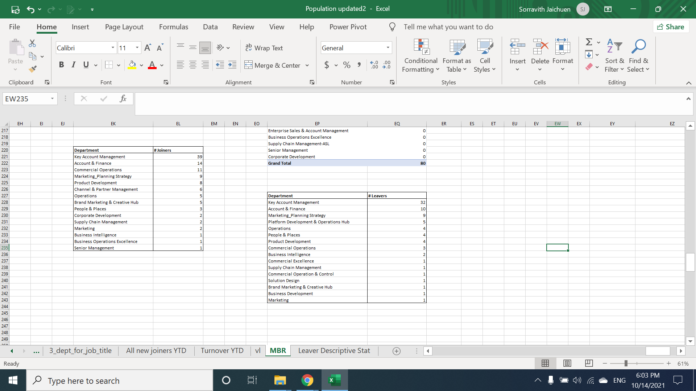
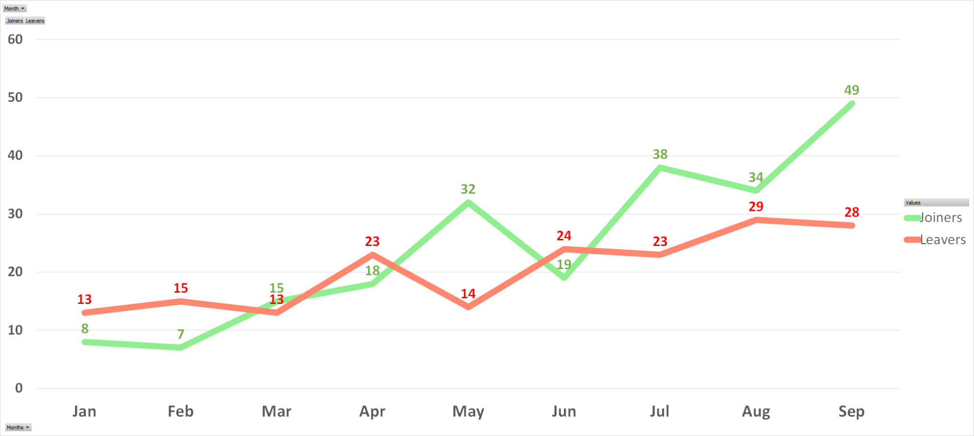
Quarterly Summary
New Joiners by Department
Leavers by Departments
Q3-2021 Total New Joiner: 109
Total Resignation: 80
Month on Month Leaver vs. Joiner (Jan - Sep)

Slide 6
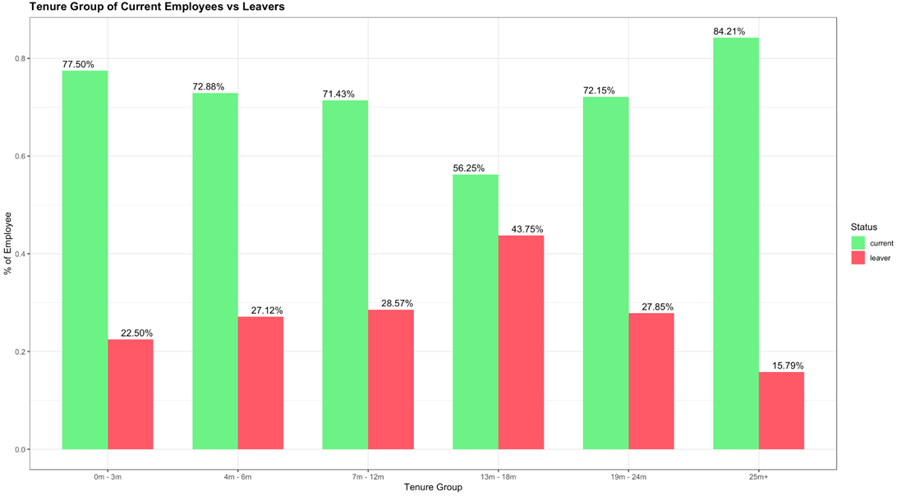
How long employees stay with us?
Key Takeaway:
Employees that work with us for 1 year to 1.5 year are the most at risk of leaving
Compare within the same tenure
YTD Headcount : 596
YTD Exit : 182

Slide 7
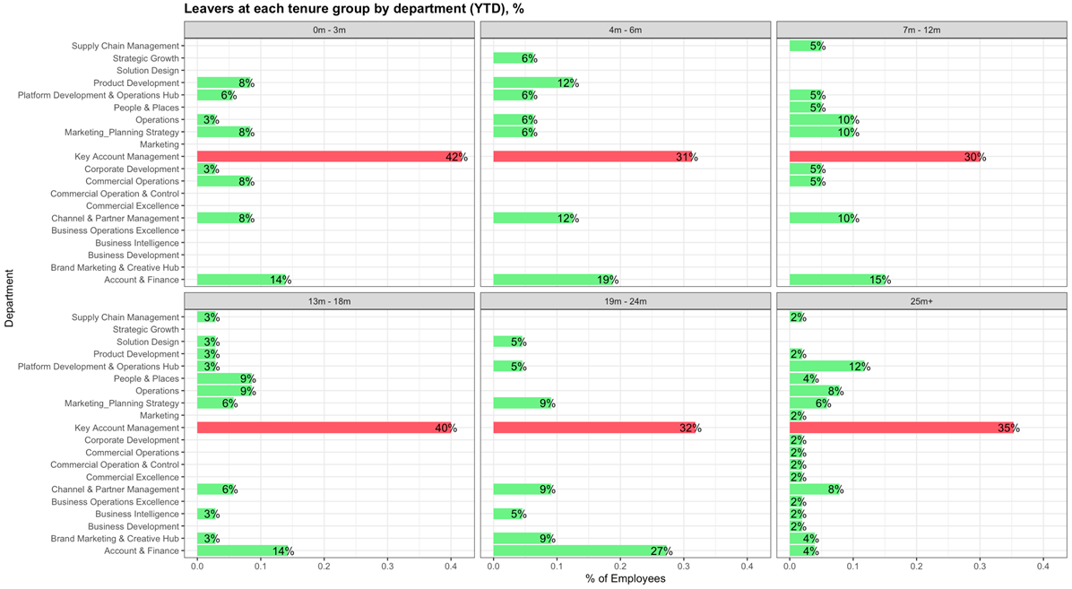
Leavers at each tenure by departments
Key Takeaway:
Compare within each tenure, KAM is the most likely to exit
Leavers in every tenure, more than 30% which are from KAM

Slide 8
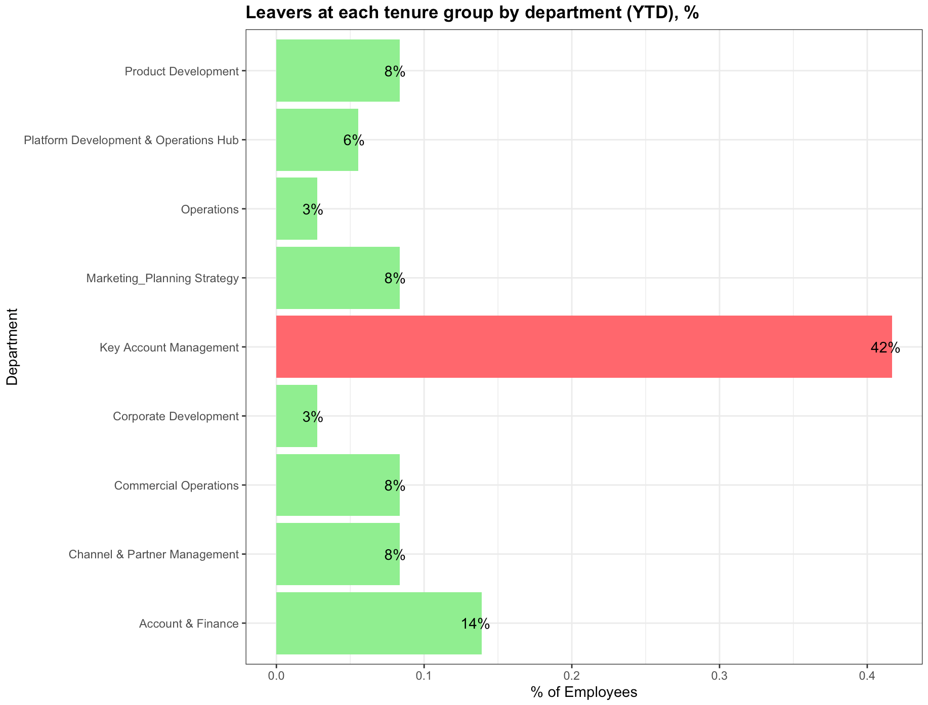
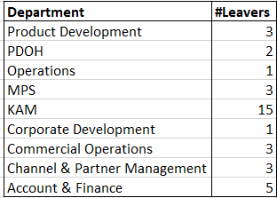
Leavers at 0m-3m tenure by departments
# of Leavers (< 3m) : 36
Key Takeaway:
Compare within tenure, KAM is the most likely to exit
Leavers in <3ms tenure, more than 42% are from KAM

Slide 9
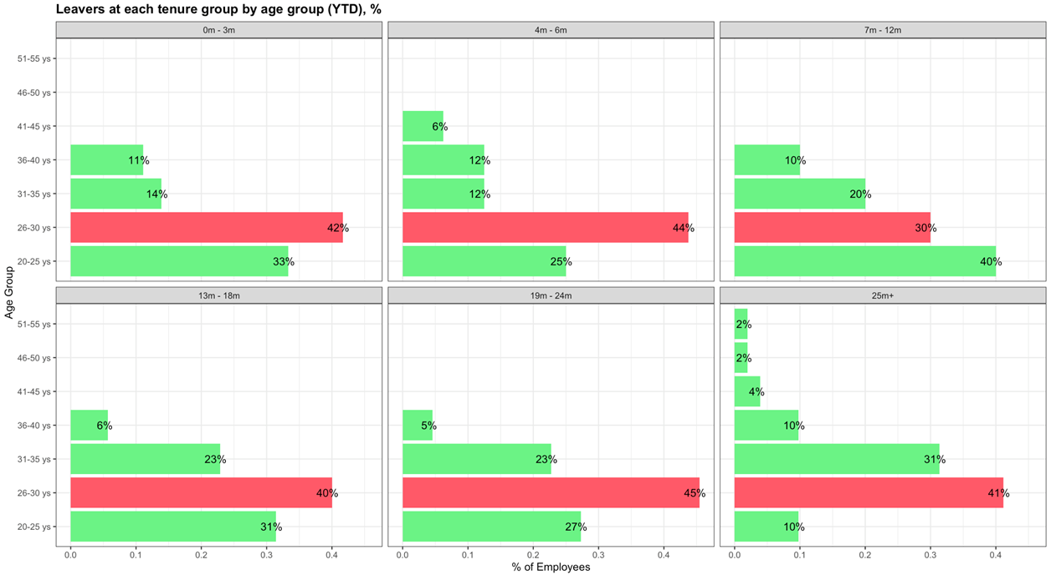
What about the age? Is that related?
Key Takeaway:
Age between 26-30 ys is the one that decided to leave the most in every tenure
Juniors (20-25 ys) tend to leave at one year tenure
Compare within each tenure

Slide 10
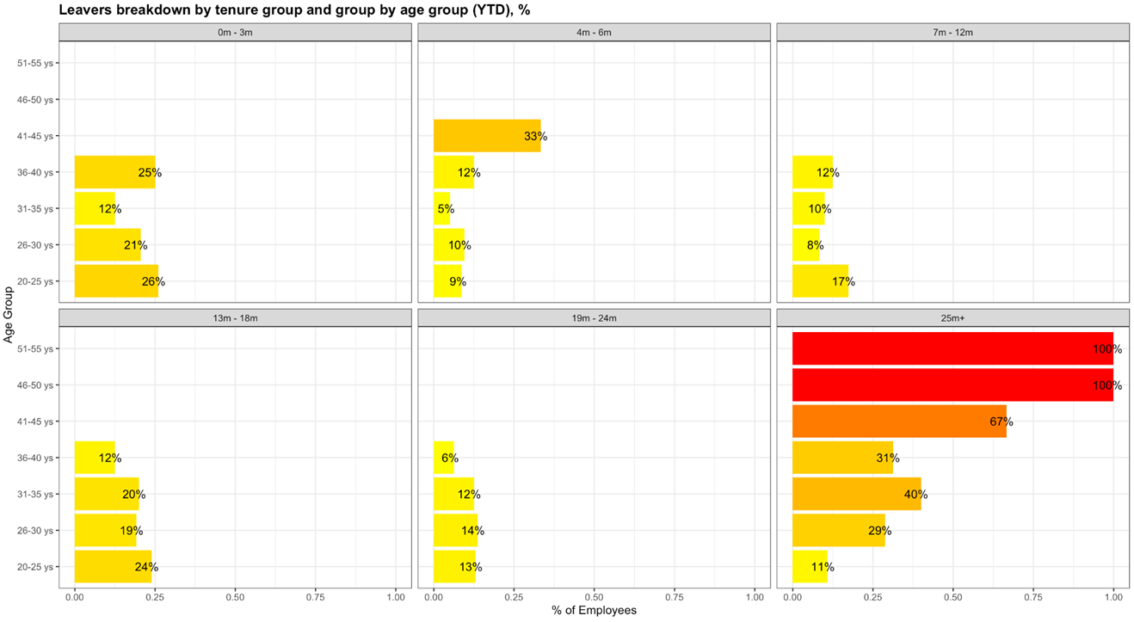
Look closely at the age
Key Takeaway:
Employees age between 20-30 tend to leave when the tenure milestones are met which are within 3 months, 1 years, 2 years
Employees with more age tend to stay longer with the company
Compare within the same age category

Slide 11
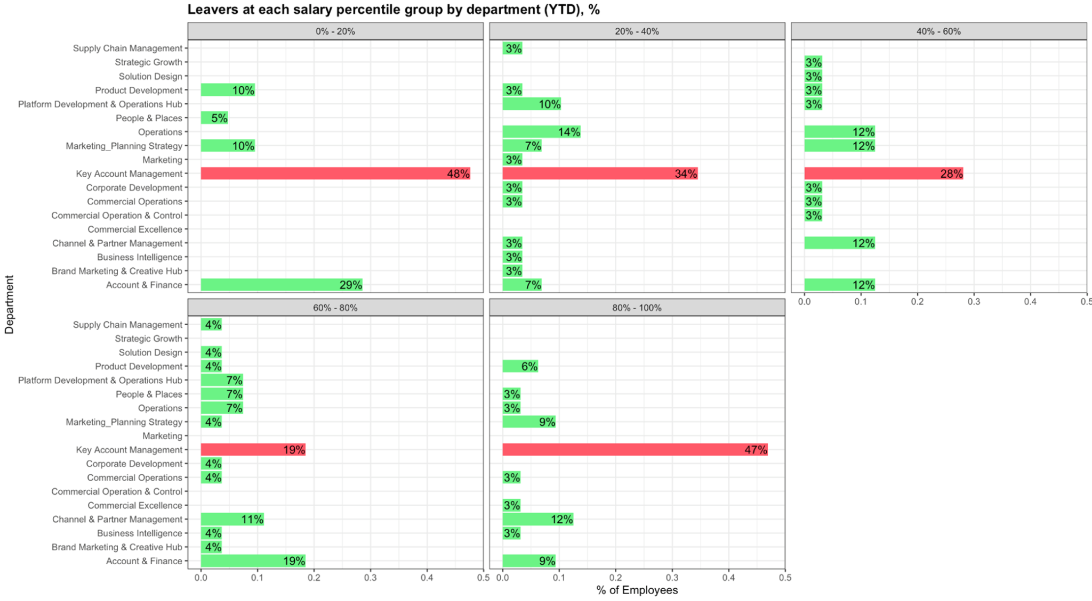
Look into the salaries of those who left
Key Takeaway:
In every salary group, KAM seems to be number one resignation on the chart
Compare within the same salary group

Slide 12
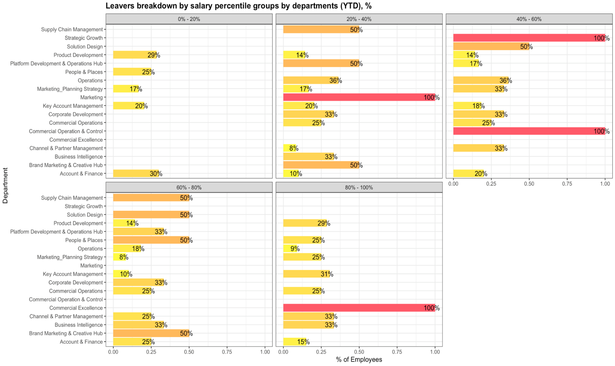
Is salary really the problem? (not likely)
Key Takeaway:
In most departments, leavers seem to spread equally across all salary percentile groups
Salary seems not to be the problem why KAM resigned
Compare within the same department

Slide 13
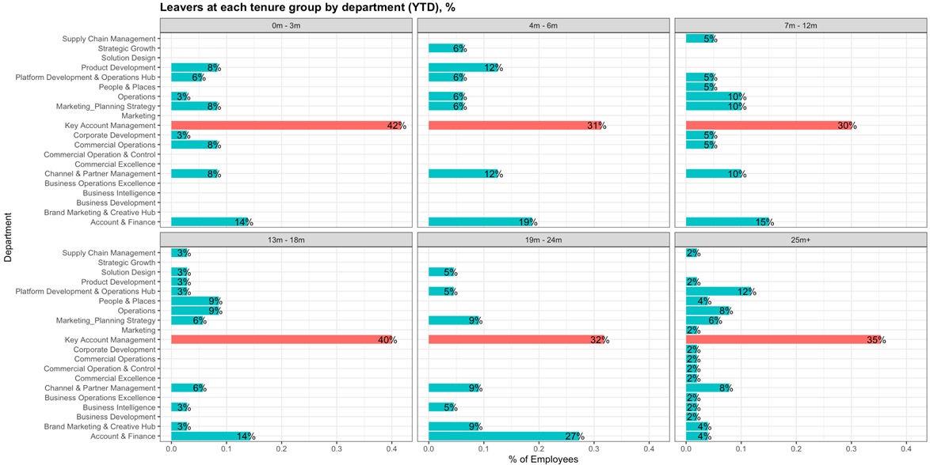
By Departments, How long they stay
Key Takeaway:
In every tenure group, KAM resigned the most and followed by Account and Finance
Compare within the same tenure

Slide 14
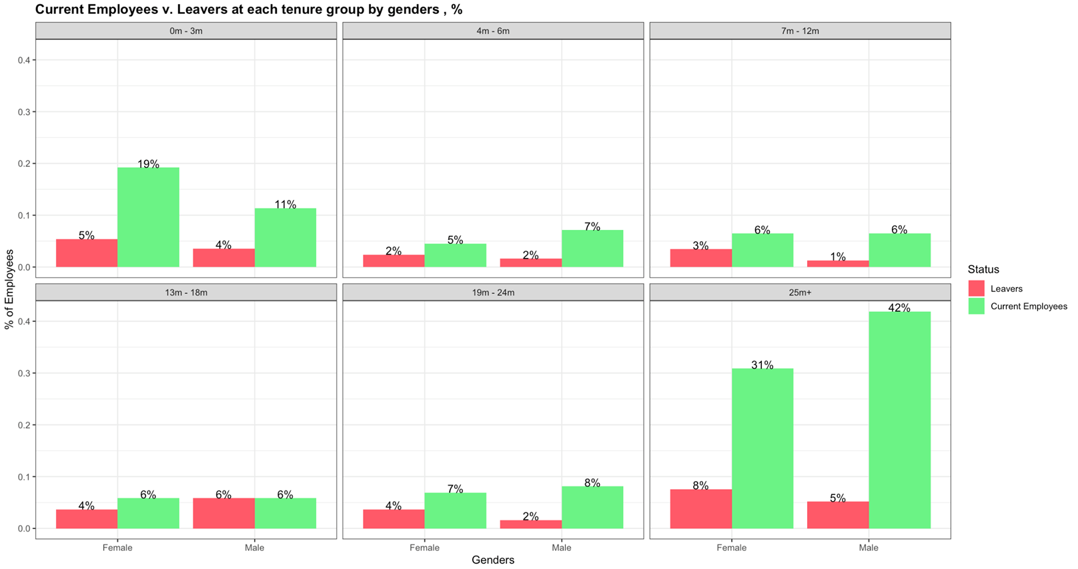
Leavers by genders
Key Takeaway:
There are no differences in male and female among the leavers
Current Active Breakdown
Male 42% (249) : Female 58% (342)

Slide 15
What about Joiners this year?

Slide 16
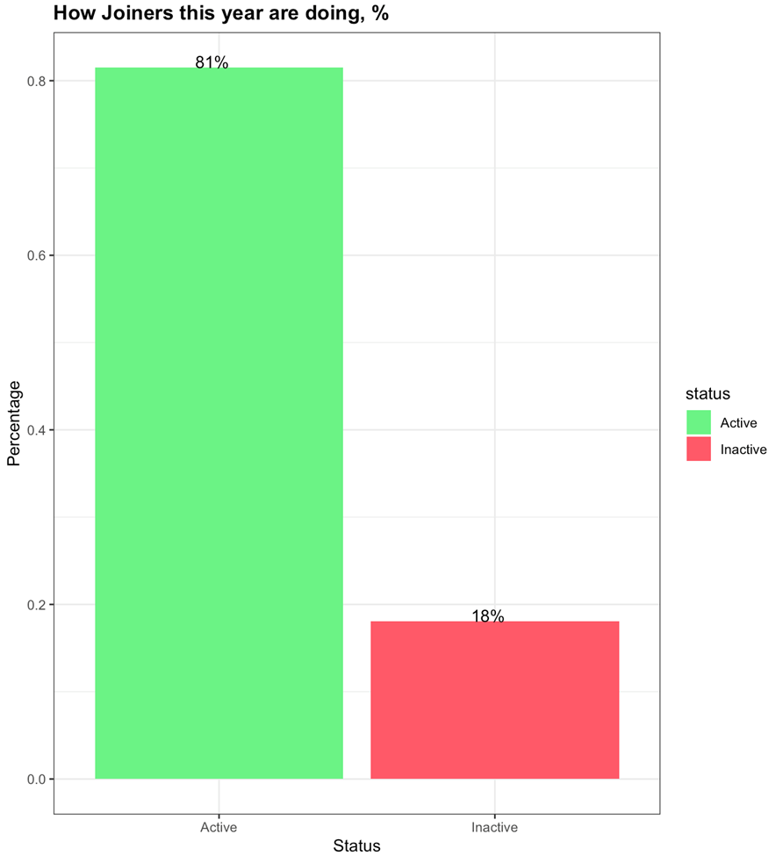
How are new joiners doing?
Key Takeaway:
Employees that joined this year from the beginning of the year until Sept 18% already left
81% is still active.
Active : 117
Inactive : 39

Slide 17
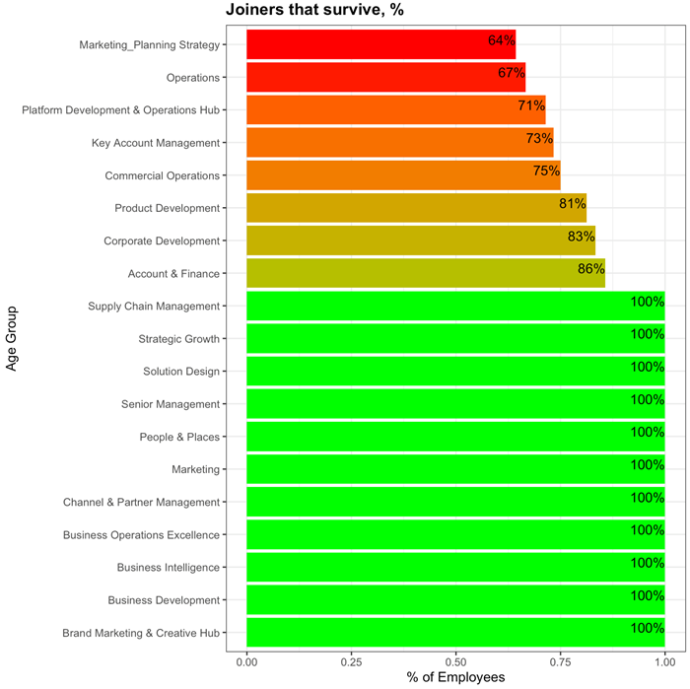
Joiners that survive
Key Takeaway:
With the survival rate, MPS manage to retain 64% of new joiners followed by Operations at 67%, PDOH at 71% and KAM at 73%

Slide 18
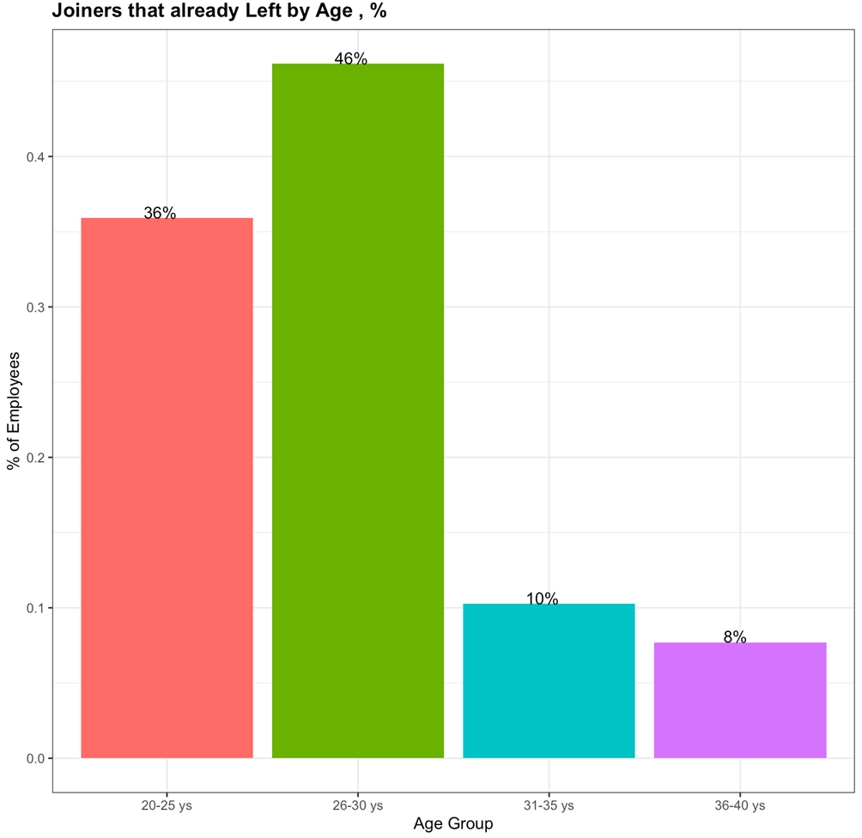
Joiners that left by age
Key Takeaway:
From 18% of joiners that already left, more than half came from 20-30 year of age employees
Joiners which age between 31-40 years old tend to stay longer with the company.
Joiners that left : 39

Slide 19
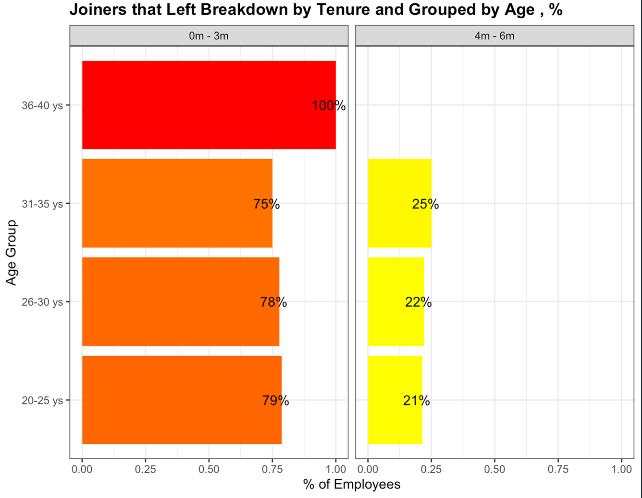
How long they stay with us
Key Takeaway:
Joiners that left left within 3 months
Critical period for retaining new joiners with us is the first 3 months with the company

Slide 20
Into the realm of prediction (kind of)

Slide 21
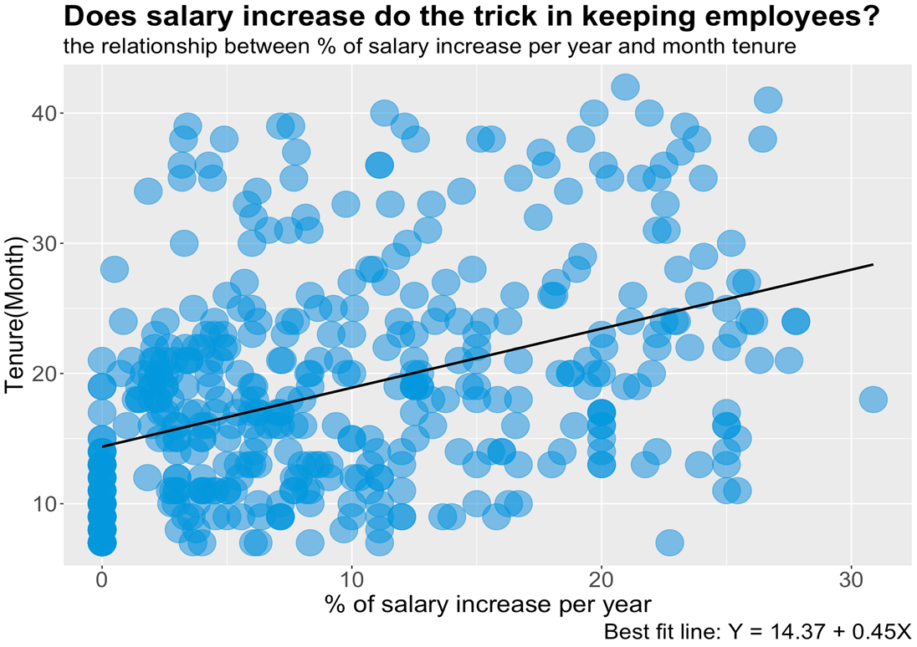
Can salary increase keep the employees with us?
Key Takeaway:
Salary can be the factor of keeping the employees with us but it account for just as much as 18%
The same relationship found across in both leavers and current employees, divisions, departments

Slide 22
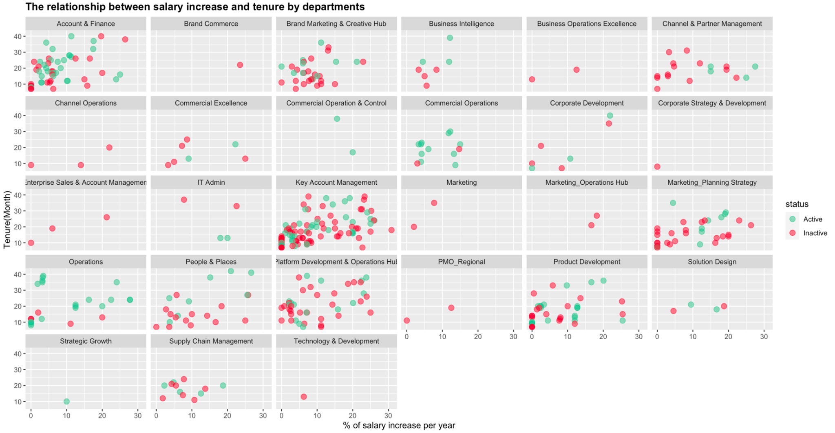
The relationship between salary increase and tenure breakdown by departments

Slide 23
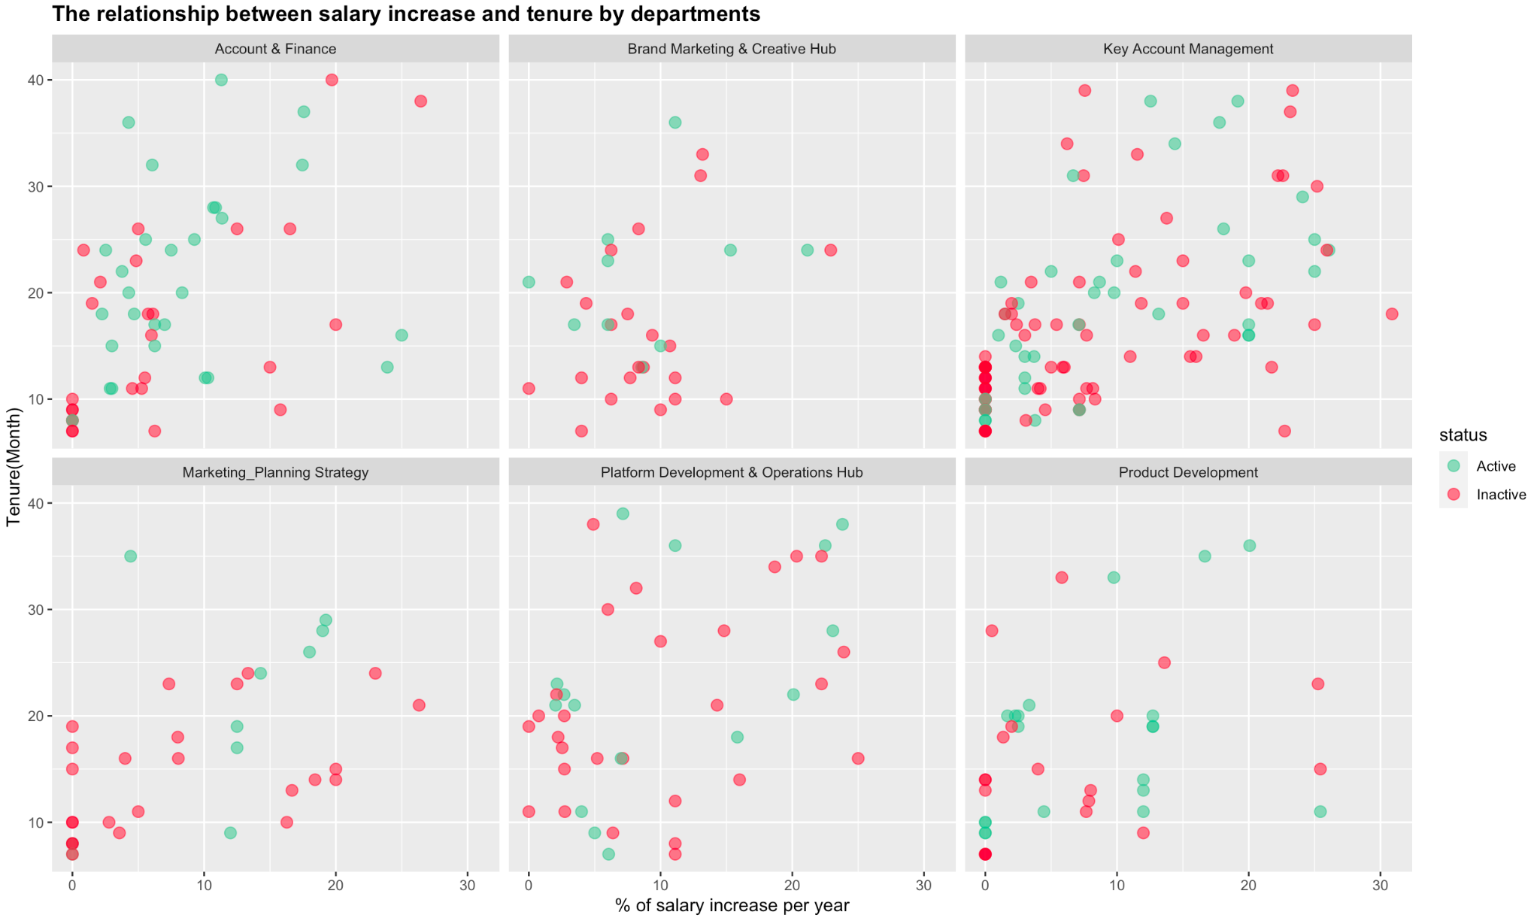
The relationship between salary increase and tenure breakdown by 6 departments

Slide 24
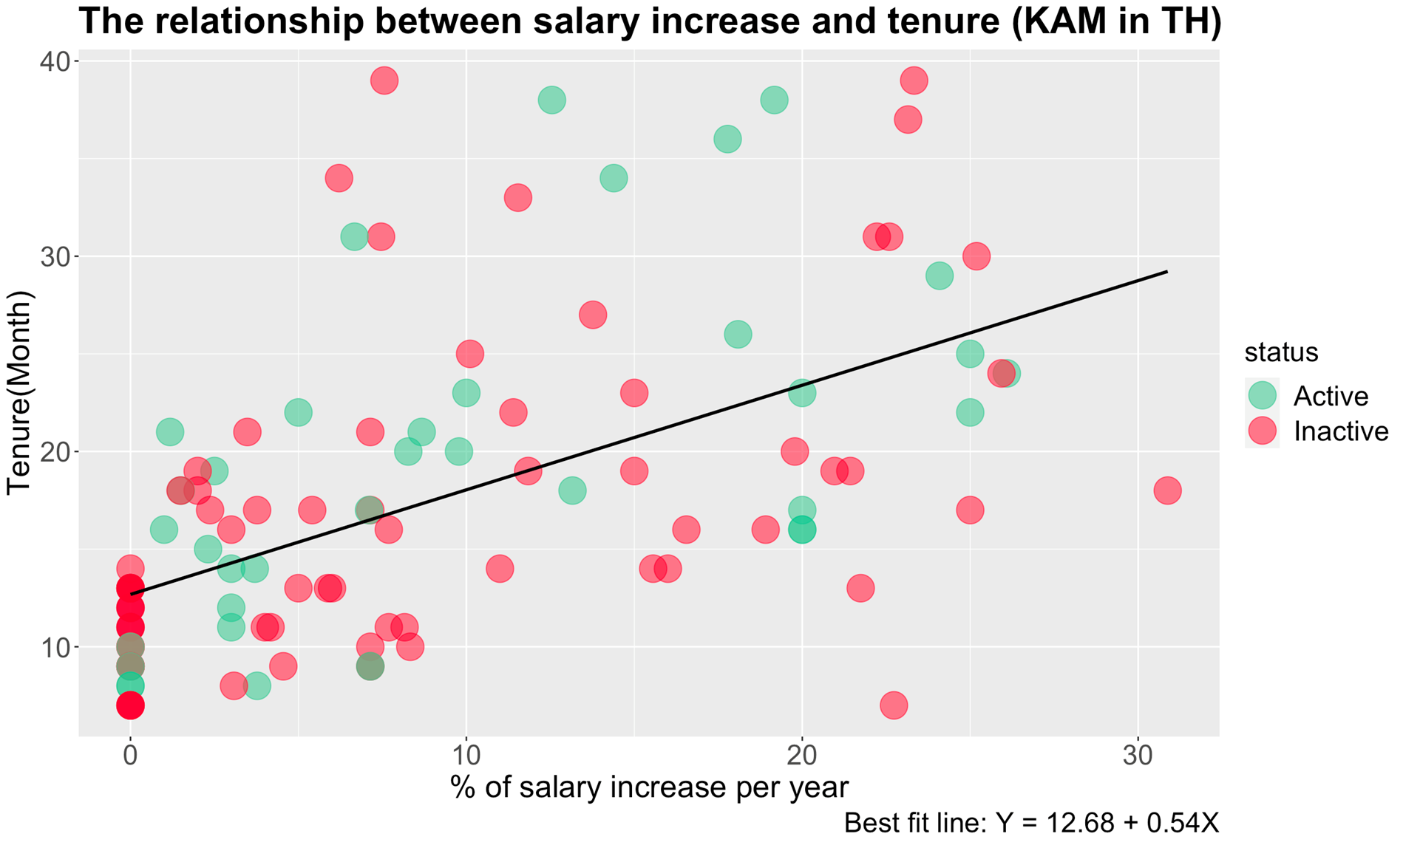
The relationship between salary increase and tenure breakdown (KAM TH only)
Key Takeaway:
Salary can be the factor of keeping the KAM employees with us but it account for just as much as 31%

Slide 25
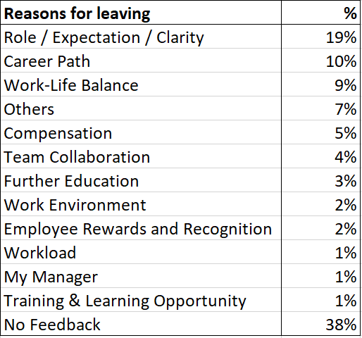
EXIT Interview Feedback so far
Top Exit Reason YTD
Role / Expectation / Clarity:
“Expectation don't match the actual job description. I thought this job is more focused on digital marketing.”
Career Path:
“Primary: Lack of career path. Where's my position going? I asked a few times but I didn't get a clear answer.”
Work-Life Balance:
“No work life balance. Heavy workload. I sleep at 4AM almost everyday recently. I take care of Abbot. Higher target, less manpower. Process of requesting more headcount is difficult too. with Abbott, meetings start at 7PM end at 8PM and they would request a report by 6PM on the following day.”

Slide 26
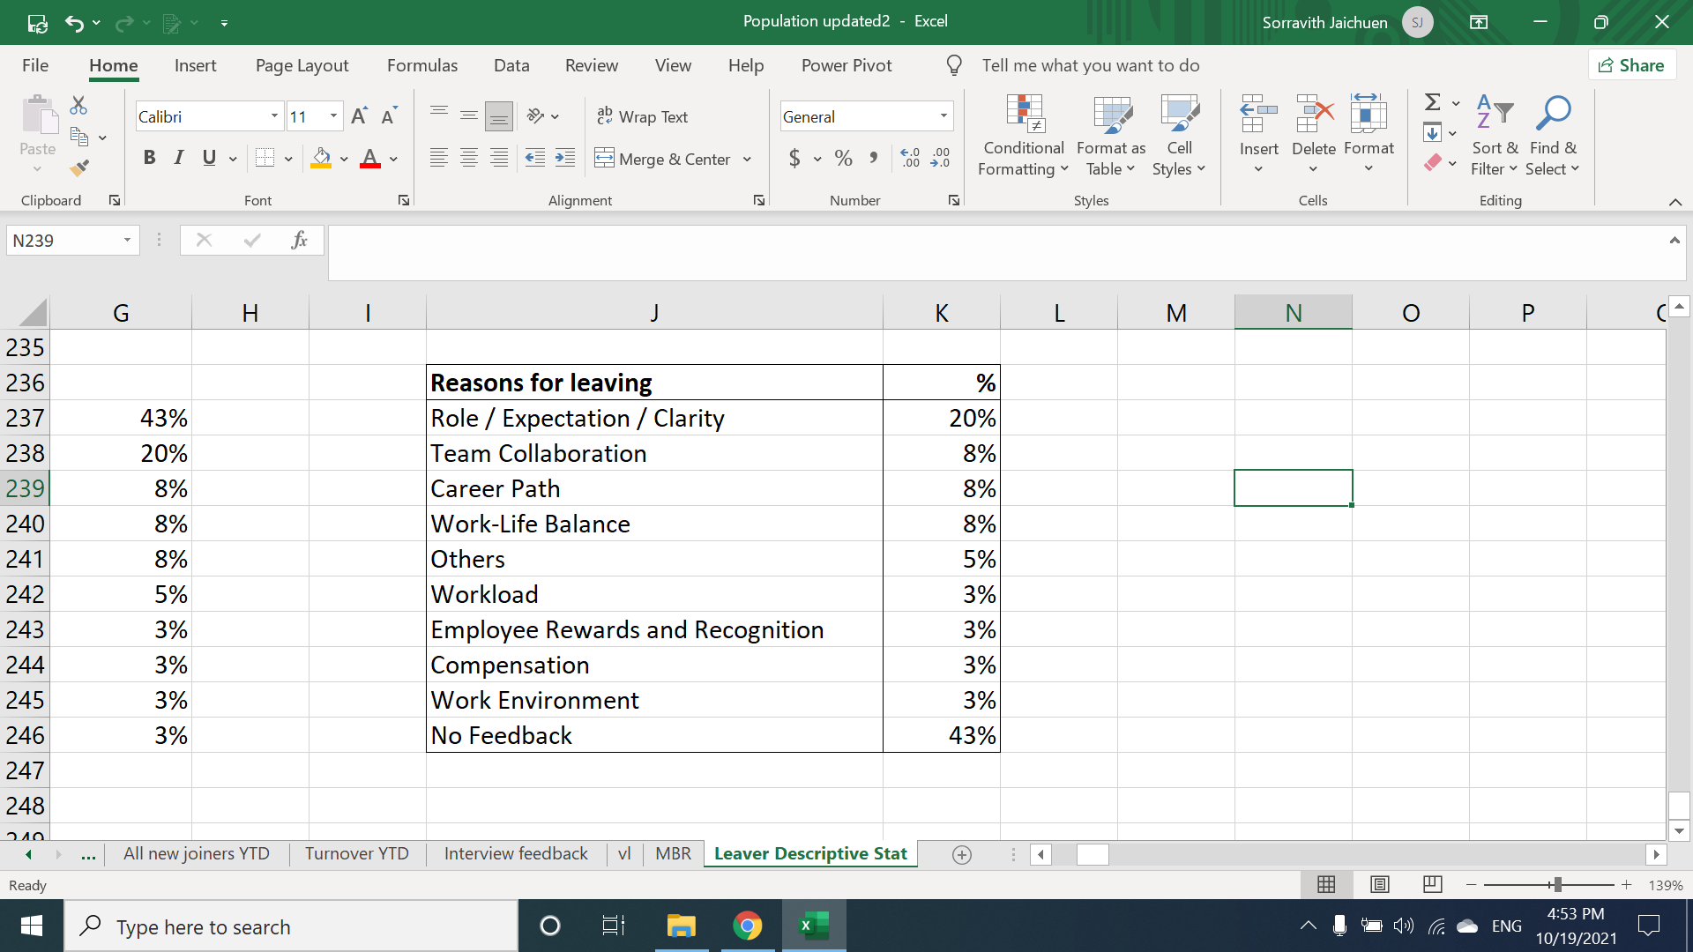
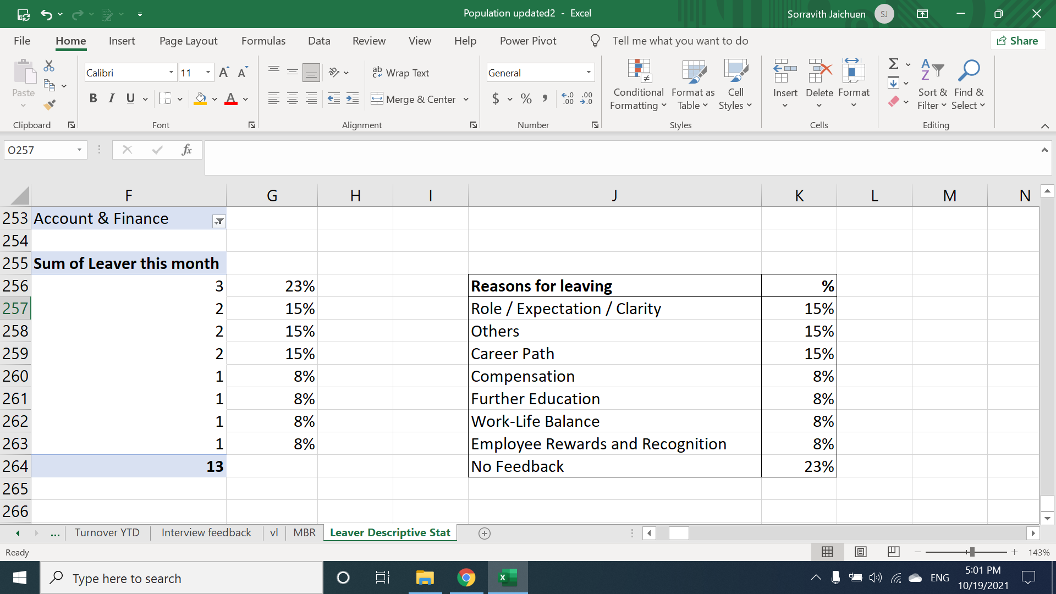
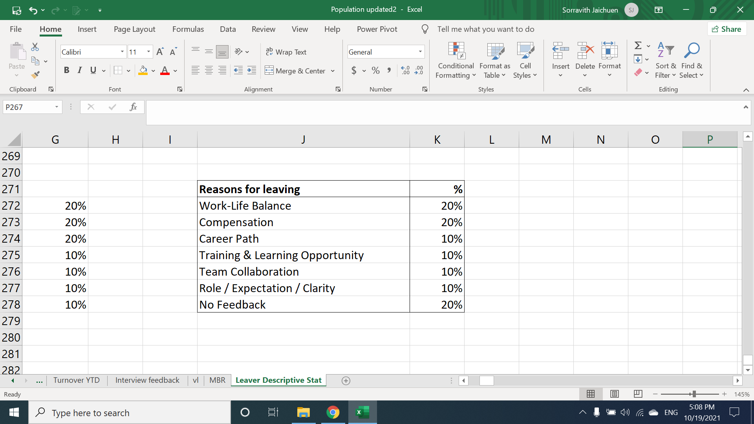
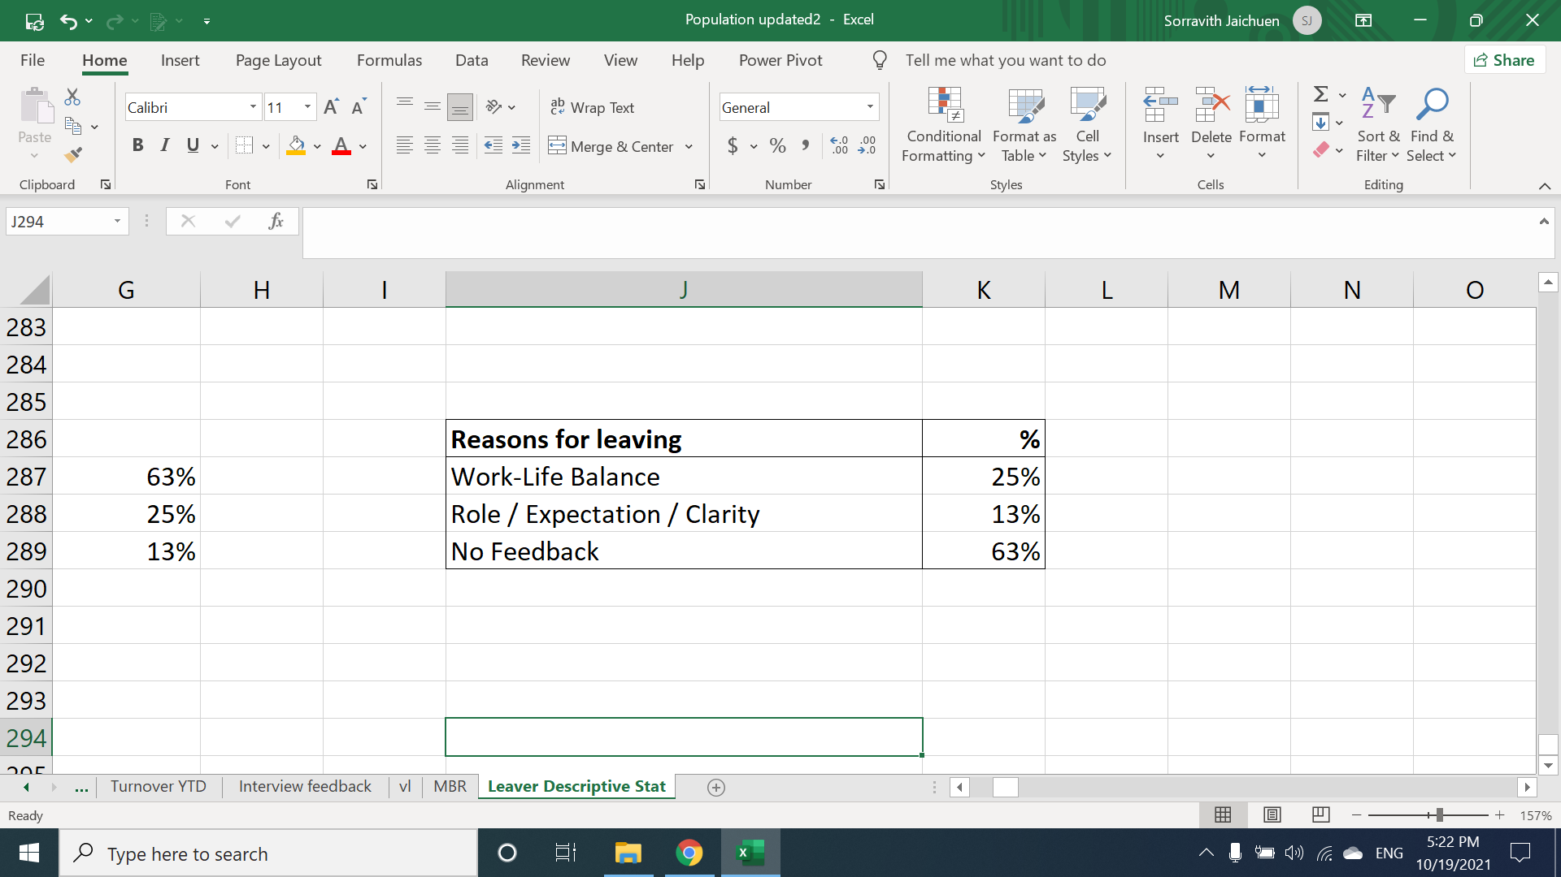
Top Exit Reason by 5 Departments
KAM
Account
MPS
Platform Development and Operations Hub

Slide 27
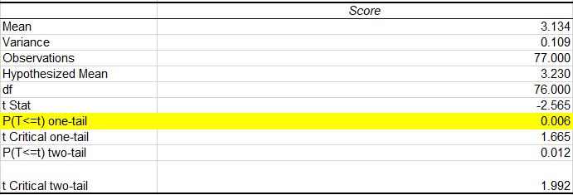
What is the difference between leavers and current employees? (look at eNPS)
One sample t-Test
Key Takeaway:
We found significant difference between two group by using one sample t-test
Most leavers rated themselves that they didn’t how their performance are measured.
Significance
The Lowest Engagement Score;
Work-Life Balance (2.73)
Clear Career Path (2.83)
How performance is measured (2.97)
Understand company’s vision and mission (2.99)
Safe and Comfortable Working Environment (2.99)

Slide 28


Conclusion
Current Turnover
Rate
Average Year
of Working
Year of Age
Q3: 80 Leavers 109 Joiners
YTD: 32% turnover rate
with the great portion of leavers came from KAM
Most of employees left the company at their 1 year tenure
42% of leavers in less-than-3-months tenure are
KAM
In every tenure group, 26-30 years old tend to leave the most.
Junior employees (20-25 years old) tend to leave at 1 year milestone.

Slide 29



Conclusion
New Joiners
This Year
Salary
Feedback
Ex-employees said they left because of role expectation, unclear career path, work-life balance.
eNPS said that ex-employees didn’t really understand how their performance are measured
18% have already left. Mostly came from MPS, PDOH, KAM
Those who have already left age between 20-30 years old.
Salary seems not to be the only problem why employees left
Salary can keep the employees with us but accounts for 18% of the reasons why they left

Slide 30
Next Steps
Be honest with the candidates
TAs and hiring managers must be clear with the candidates about the actual job and what’s described in JD in order to set the same expectations which will help in job mismatch or misunderstood
Hiring
Set clear career path
Management and managers must set clear and reasonable career path in every position to let employees know what’s in it and what’s the next step for them.
Career Path
Respect employees’ time-off
Create a culture that have the right to disconnect and respect employees’ working hours and leaves
Respect
Transparency in promoting and recognition
Set clear and fair evidence-based regulations with employees about promotion and recognition. This will help in transparency when promoting someone instead of someone.
Transparency

